Slide 1
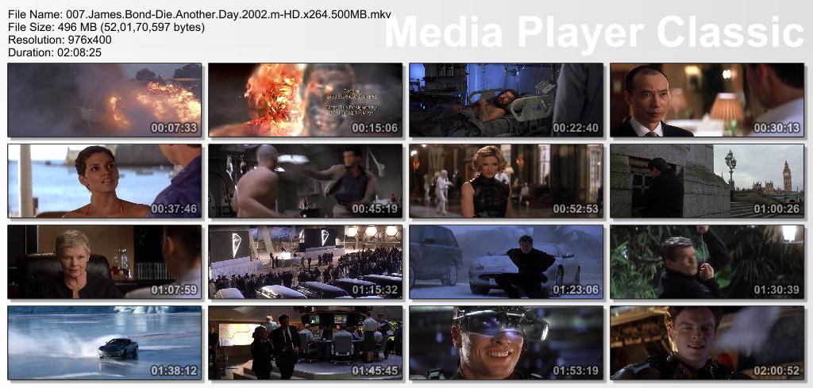
AAWAAZ
You gotta raise it sometimes to make a change…

Slide 2
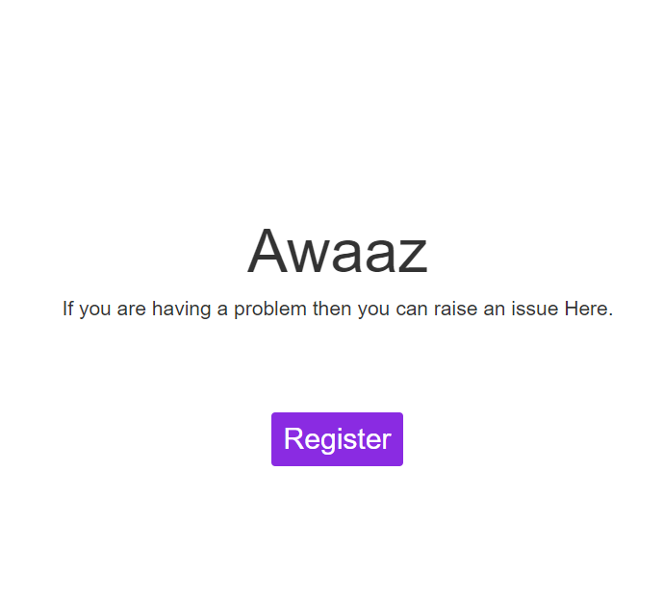

Slide 3
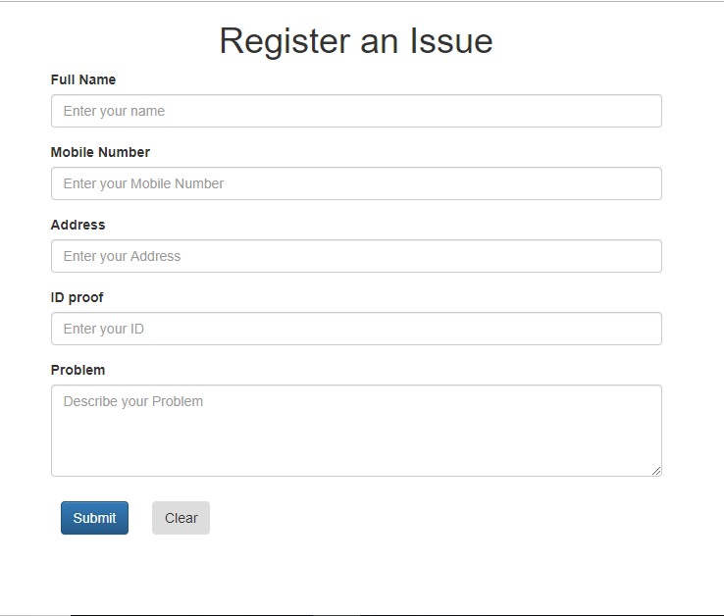

Slide 4
Guys, in today's world social media has taken over our life drastically.
What happens in our life ought to take place beforehand on these sites, untill when
we don't really achieve purpose of life. All I am saying is that social media is a very powerful
tool to connect masses nut it is not being used in a optimum way.

Slide 5
So, our idea towards this fact is that how can we extract fruitfull things from this
which in turn would help in the welfare of society.
Goverment is trying their best to implement many things which is quite noticable through
campaigns like SWACCH BHARAT ABHIYAN , BETI PRRAHO BETI BACHAO and all. But we know that
all that it wants to provide is either not actually reachable to us or we are not aware of the
available resources.

Slide 6
We will bulid an platform, a #webapp, where people will interact like any other sites resembling
facebook or twitter. But here the main and only theme will be to actually spread awareness about
various things for social cause.

Slide 7
Some of the features of the
application will be:-

Slide 8
Anyone can raise an issue, any complaint about anything. And if that particular post is acknowledged by a adequate number of users than concerned NGO's and other authorities must try to systematically solve that issue.

Slide 9
As much possible organisations and authorities must be linked with the site who can attend the users.

Slide 10
* For instance, say I have many poor kids in my locality and I think they must get proper education instead of posting only emotional thoughts on facebook I can raise this issue to the sight of other's concern. This will attract the attention of users and authorities present in the site. May some good person want to do charity and donate enough amount for setup of school or may be the organisations take the case to higher ends and get some order passed.

Slide 11
If anyone finds himself cheated or a victim of corruption then also one can go for a post on the site and make their suffering to come upon other’s attention.

Slide 12
Inshort- Be it Health care centers, public toilets, roads, sewer and waste disposal, bad services from government organisations or anything, if you feel like doing something for the society don't just speak about it in your stories and statuses take a step forward and put the media to a better use.

Slide 13
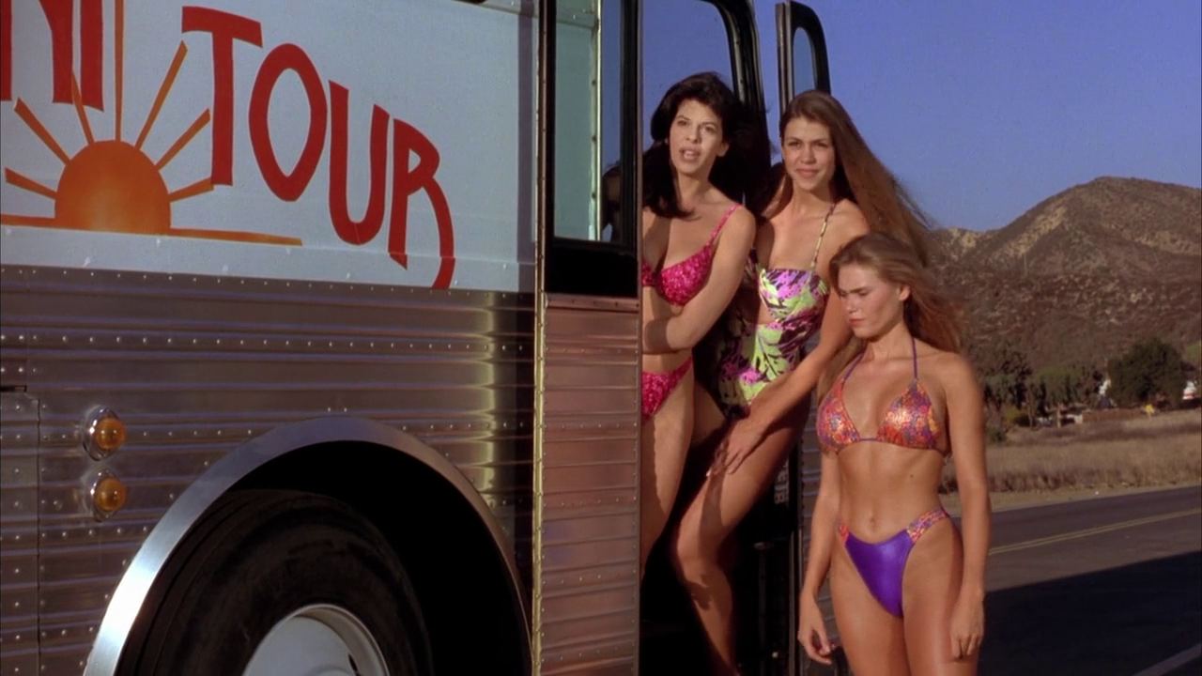
Presented by:-
ELEMENT X

Slide 14

THANK YOU

